Slide 1

An introduction to
\LaTex{}
Presentation by Ananya Ravikumar

Slide 2
What is Latex?
LaTeX (pronounced ‘lah-tech’ or ‘lay-tech’) is a typesetting software.
TeX : A typesetting program created by Donald Knuth in 1977.
LaTex is a set of macros system built on top to TeX to simplify its use. Written by Leslie Lamport.
Why Latex?
Powerful, consistent, fine level of control
Free, stable, runs on many kinds of computers
Inserting mathematical symbols, equations, tables, figures is easy.
Page/figure/section/table/reference numbers are set automatically.
Great support for bibliography
Publishers offer templates for consistency
Allows the writer to focus on content rather than appearance!
Fun Fact: The version numbers of TeX are converging toward π,with a current version number of 3.1415926.
Notes:
Donald Knuth : Author - The Art of Computer Programming. He contributed to…rigorous analysis of the computational complexity of algorithms…popularized the asymptotic notation.
Leslie B. Lamport : best known for his seminal work in distributed systems and as the initial developer of the document preparation system LaTeX. Leslie Lamport was the winner of the 2013 Turing Award[3] for imposing clear, well-defined coherence on the seemingly chaotic behavior of distributed computing systems…These contributions have resulted in improved correctness, performance, and reliability of computer systems.

Slide 3
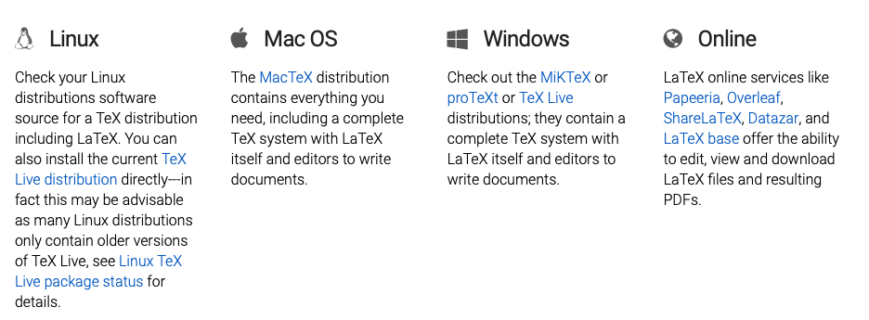
InstallING Latex
“LaTeX is not a stand-alone typesetting program in itself, but document preparation software that runs on top of Donald E. Knuth's TeX typesetting system. TeX distributions usually bundle together all the parts needed for a working TeX system and they generally add to this both configuration and maintenance utilities. Nowadays LaTeX, and many of the packages built on it, form an important component of any major TeX distribution.”
OR USE IT ONLINE
Source: https://www.latex-project.org/get/

Slide 4

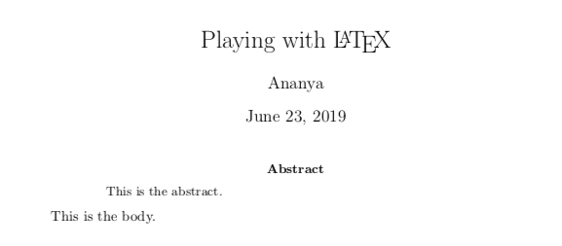
Creating your first document
Other document classes: article, report, book,…
\documentclass{article}
%\usepackage{amsmath}
\begin{document}
\title{Playing with \LaTeX{}}
\author{Ananya}
\maketitle
%\date{} %To remove/use a sp. date
\begin{abstract}
This is the abstract.
\end{abstract}
This is the body.
\end{document}
Add packages for additional functionality
Use ‘%’ for comments

Slide 5
how latex works
An explanation for the file explosion*
.tex : This is the file that contains your document and the your typesetting instructions.
.bib : This is the file that contains the bibliography in BibTeX format.
.log, .blg: a log file contains a transcript of the most recent LaTeX run. It lists all the files that have been loaded. Error messages, warnings and general information messages are also written to the log file as well as the document statistics. You can delete this log file if you like. It will be created again the next time you run LaTeX. blg files are Bibliography (BibTeX) log -- just like .log but for BibTeX; generated by BibTeX and can be safely deleted if there's no need to check it for errors.
.aux: Contains information needed for cross-referencing. This is needed to ensure all your cross-references are up-to-date. You can delete this file, but you will need at least two LaTeX runs to ensure your cross-references are correct the next time you create your output file.
.synctex.gz : Allows you to jump to and from the source code and the appropriate part of the output file. If you delete this file, you will have to run LaTeX again before you can use this function.(TeXWorks)
.bbl : Bibliography; this is what is outputted by BibTeX for insertion into LaTeX the next time LaTeX is run.
Output files : .pdf, .dvi (DeVice Independent), .ps (PostScript)
Style files : .cls, .sty, .bst (download as required)
https://www.dickimaw-books.com/latex/novices/html/auxiliary.html,
https://tex.stackexchange.com/questions/7770/file-extensions-related-to-latex-etc

Slide 6
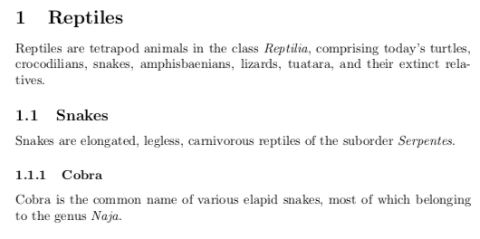
(SUB(SUB))Sections
\section{Reptiles}
Reptiles are tetrapod animals in the class \emph{Reptilia}, comprising today's turtles, crocodilians, snakes, amphisbaenians, lizards, tuatara, and their extinct relatives.
\subsection{Snakes}
Snakes are elongated, legless, carnivorous reptiles of the suborder \emph{Serpentes}.
\subsubsection{Cobra}
Cobra is the common name of various elapid snakes, most of which belonging to the genus \emph{Naja}.

Slide 7
TEXT MANIPULATION
[B, I , U] : \textit{}, \textbf{}, \underline{}
New Paragraph: \par
Emphasis : \emph{}
Newline: \\
\usepackage{lettrine}…. \lettrine{B}{egin}

Slide 8
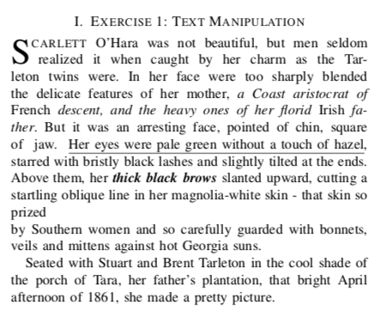
Exercise:text Manipulation
\lettrine{S}{carlett} O'Hara was not beautiful, but men seldom realized it when caught by her charm as the Tarleton twins were. In her face were too sharply blended the delicate features of her mother, \textit{a Coast aristocrat of \emph{French} descent, and the heavy ones of her florid \emph{Irish} father}. But it was an arresting face, pointed of chin, square of jaw. \underline{Her eyes were pale green without a touch of hazel}, starred with bristly black lashes and slightly tilted at the ends. Above them, her \textbf{\textit{thick black brows}} slanted upward, cutting a startling oblique line in her magnolia-white skin - that skin so prized \\by Southern women and so carefully guarded with bonnets, veils and mittens against hot Georgia suns.
\par Seated with Stuart and Brent Tarleton in the cool shade of the porch of Tara, her father's plantation, that bright April afternoon of 1861, she made a pretty picture.
Gone With the Wind, Ch 1 - Margaret Mitchell

Slide 9
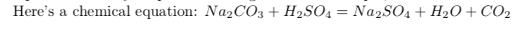
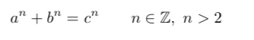
Equations in latex
You’ll never look back!
Math mode : $ … $
Equation environment: \begin{equation} … \end{equation}
Aligning Equations: \begin{align} … \end{align} (use ‘& ‘to align )
Subequations: \begin{subequation} … \end{subequation}
Example 1: Math Mode:
In LaTex : Na_2CO_3 + H_2SO_4 = Na_2SO_4 + H_2O + CO_2
Example 2: Equation
In LaTex : \begin{equation}
\label{eq1}
a^n + b^n = c^n \qquad n \in \mathbb{Z}, \ n>2 % requires package amssymb
\end{equation}

Slide 10
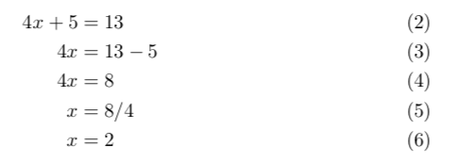
Equations in latex - 2
Example 3 - Align: (\usepackage{amsmath})
Solve the linear equation 4x + 5=13
\begin{align}
4x + 5 &= 13 \\
4x &= 13-5\\
4x &= 8\\
x &= 8/4\\
x&=2
\end{align}

Slide 11
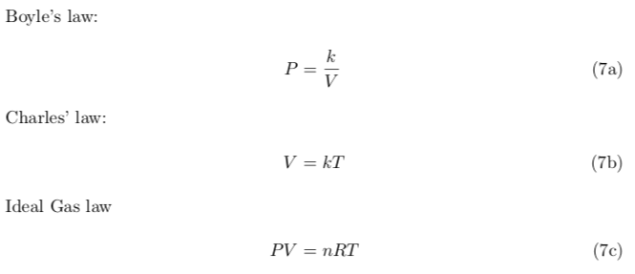
Equations in latex - 2
Example 4 -Sub-equations:
Ideal gas equations
\begin{subequations}
\begin{align}
\intertext{Boyle's law:}
P&=\frac{k}{V}\\
\intertext{Charles' law:}
V&=kT\\
\intertext{Ideal Gas law}
PV&=nRT
\end{align}
\end{subequations}

Slide 12
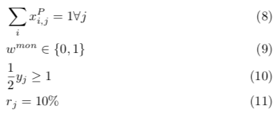
Equations in latex -3
More examples:
\begin{align}
&\sum_i x^P_{i,j} = 1 \forall j \\
&w^{mon} \in \{0,1\} \\
&\frac{1}{2} y_{j} \geq 1 \\
&r_{j} = 10\%
\end{align}

Slide 13
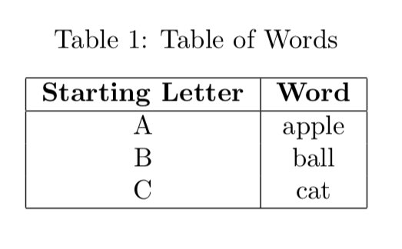
Tables
\begin{table}[h]
\caption{Table of Words}
\begin{center}
\begin{tabular}{|c|c|} % c = center, |=v. line
\hline
\textbf{Starting Letter}&\textbf{Word}\\
\hline
A&apple\\
B&ball\\
C&cat\\
\hline
\end{tabular}
\end{center}
\label{default}
\end{table}

Slide 14
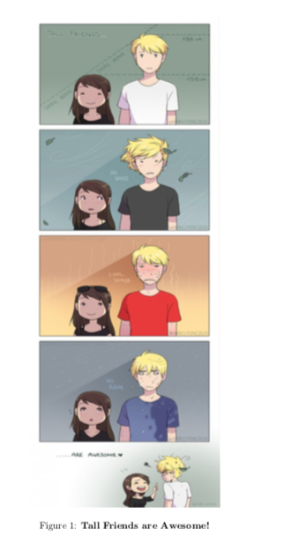
Inserting Figures
\begin{figure}[h]
\begin{center}
\includegraphics[width=70mm, height=180mm]{tall_fr.jpg}
\caption{{\bf Tall Friends are Awesome!}}
\label{fig1}
\end{center}
\end{figure}
You can control:
Dimensions, alignment
Position (to some extent)
Caption, label
file type

Slide 15
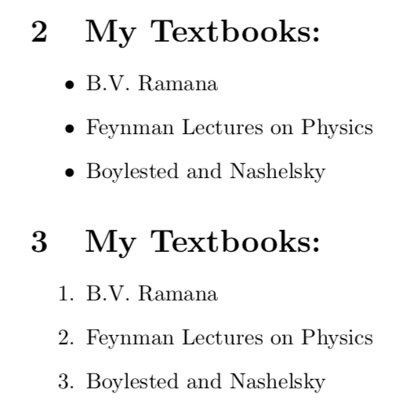
Lists and enumerations
\section{My Textbooks:}
\begin{itemize}
\item B.V. Ramana
\item Feynman Lectures on Physics
\item Boylested and Nashelsky
\end{itemize}
\section{My Textbooks:}
\begin{enumerate}
\item B.V. Ramana
\item Feynman Lectures on Physics
\item Boylested and Nashelsky
\end{enumerate}

Slide 16
Bibliography and bibtex
Create a .bib file with all of your references.
\bibliographystyle{} : In the beginning
\bibliopgraphy {mybib.bib}: (wherever you want it to appear)
Compile with Latex. : aux files created.
Compile with Bibtex.
Compile with LaTex :Bibliography appears
Compile with LaTex : Citations appear
How to cite: \cite{}

Slide 17
More fun stuff you can try
\usepackage{pdfpages}
\includepdf[pages={1,2,3}]{/Users/Ananya/Desktop/Report/cover_Ananya.pdf}
\tableofcontents
\listoffigures
\listoftables
Links shared in chat (24/07/2022) :
http://mirrors.ibiblio.org/CTAN/fonts/fontawesome5/doc/fontawesome5.pdf
https://latex.codecogs.com/eqneditor/editor.php
https://webdemo.myscript.com/views/math/index.html
https://webdemo.myscript.com/views/math/index.html

